Slide 1
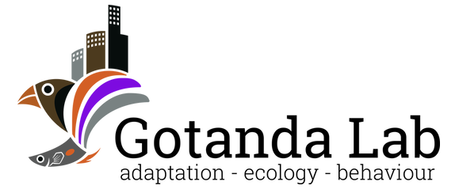

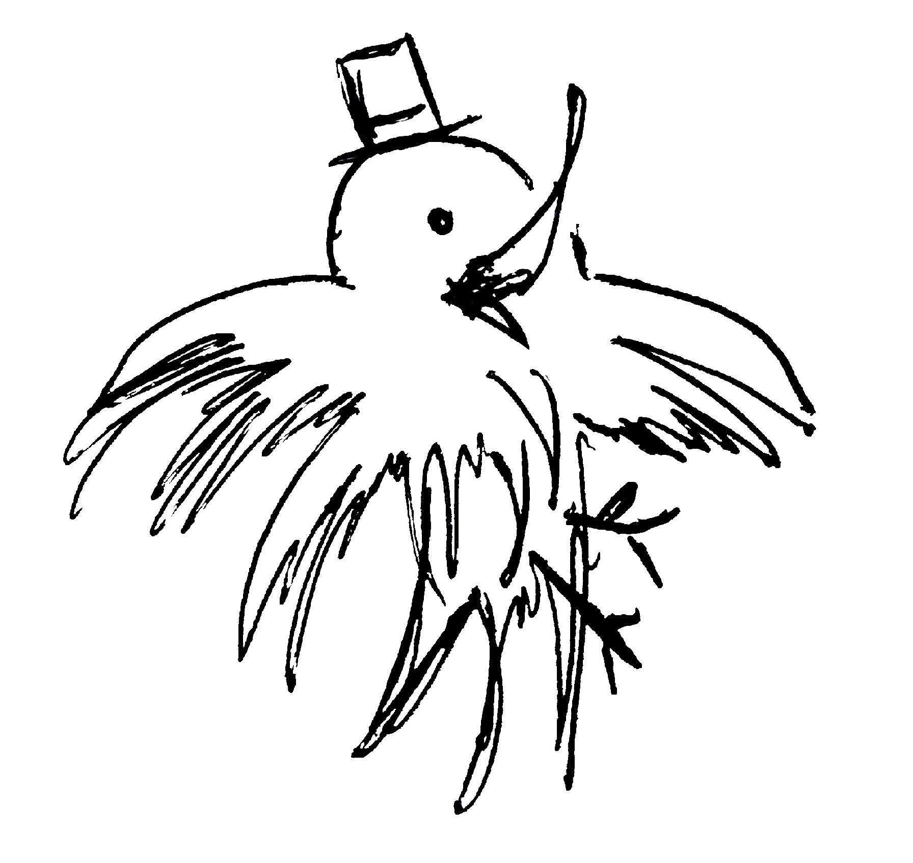
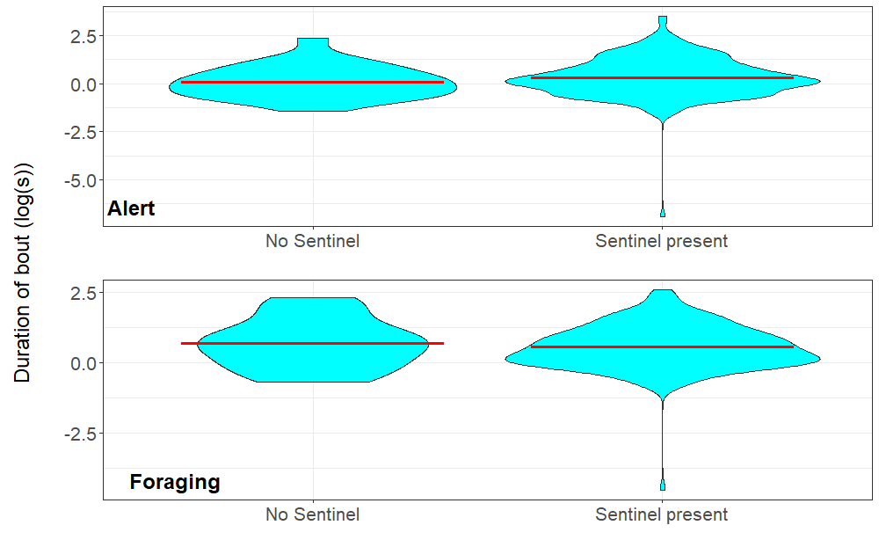
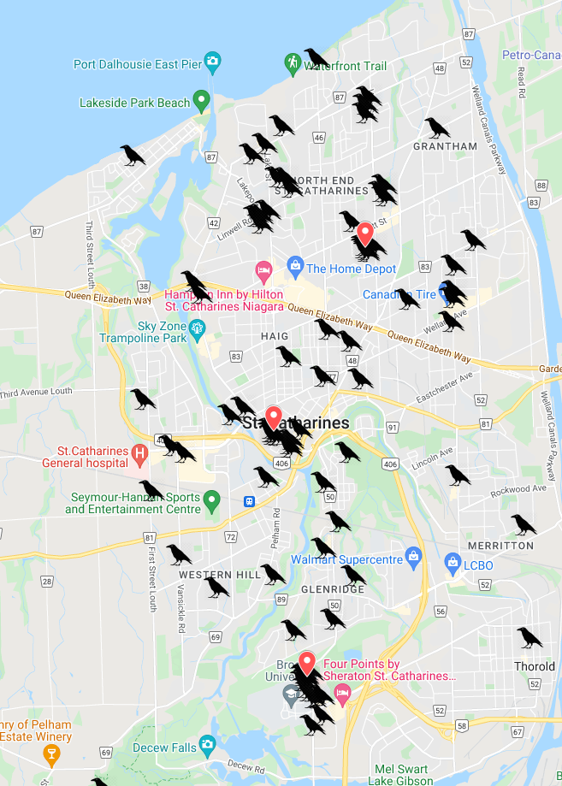
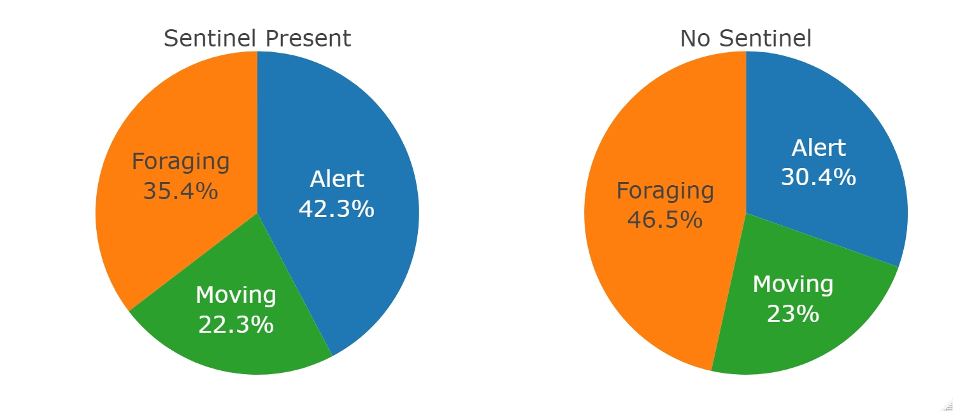
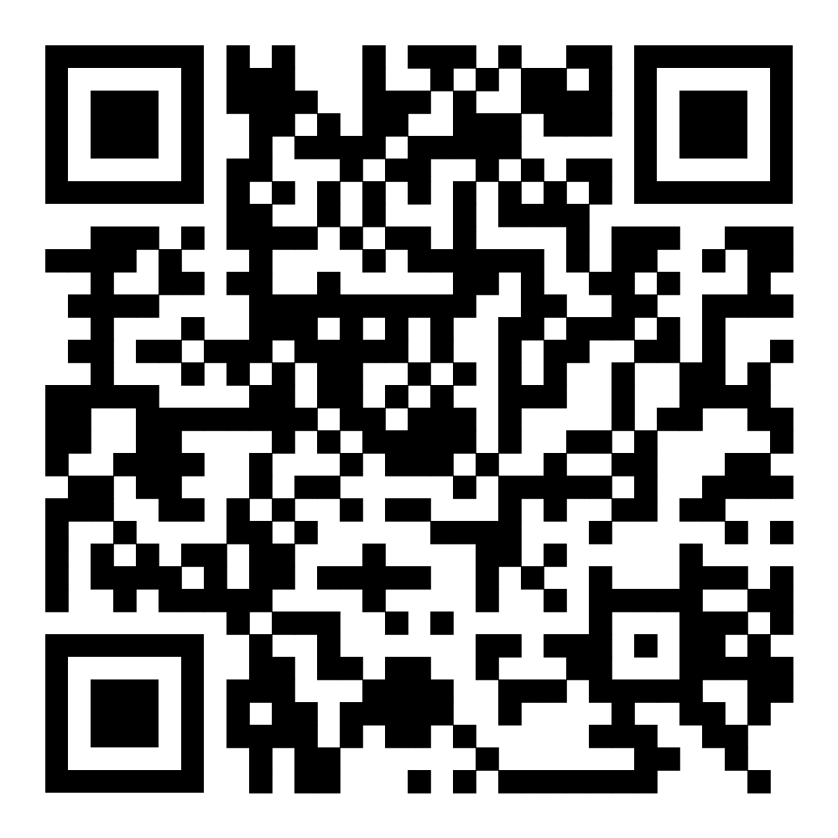
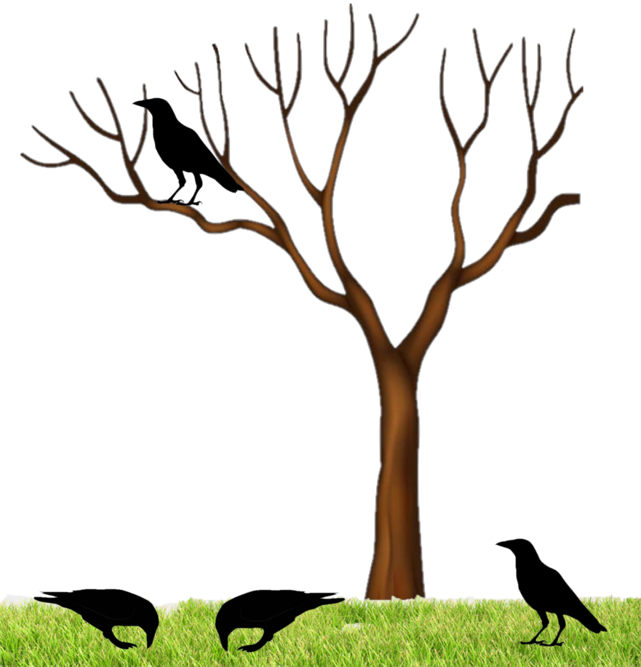
Heads up! Sentinel and foraging behaviors in urban American crows Alex Popescu – ap21pb@brocku.ca – crowkemon.weebly.com Department of Biological Sciences, Brock University
Introduction
The abundance of American crows in North American cities has increased over the years, suggesting that they benefit from living in urban areas. Urbanized species can have adaptive behaviors to better exploit anthropogenic benefits. Adaptations at the individual level have been observed in many species and include changes in foraging behavior and decreased wariness of humans. However, adaptations of social behaviors remain underexplored.
Social behaviors, such as sentinel behavior, can have a significant impact on a species’ success. The American crow, a social and urbanized bird, is an excellent model to observe how changes in social behavior can affect its success in urban areas.
Do social behavioral adaptations contribute to the success of American crows in urban areas?
Urban areas
Access to an abundance of human food
Increased frequency of interactions with humans
New sources of stress and mortality
Sentinel behavior
Increased safety from predators
Increased foraging efficiency
Costly behavior for sentinel individual
The presence of a sentinel can lead to increased foraging efficiency.
Objectives and Hypothesis
Objective: To assess the effects of a social behavior on the success of urban American crows.
Hypothesis: The presence of a sentinel will lead to increased foraging efficiency in foraging individuals.
Predictions: The presence of a sentinel will increase the duration of foraging bouts and proportion of time spent foraging, and decrease the duration of bouts of alertness.
Preliminary Results
Bout Duration
Figure 3: The effects of a sentinel on the duration of bouts of alertness (F_{(1,235)}=[0.8984], p=0.3442) and foraging (F_{(1,194)}=[0.4072], p=0.5242).
Site selection
Figure 2: Crowkémon Go in St. Catharines. Crow markers represent individual spotting events. Red markers show May testing sites.
Time allocation
Figure 4: The effects of a sentinel on the proportion of time spent alert (F_{(1,9)}=[2.081], p=0.183), foraging (F_{(1,9)}=[2,058], p=0.185), and moving (F_{(1,9)}=[0.01], p=0.924).
Crowkémon Go
Website
Preliminary Findings
Preliminary results do not support my hypothesis. Neither the proportion of time spent foraging, nor the duration of foraging bouts increased in the presence of a sentinel.
However, the sample size and the heavily unbalanced data do not allow us to make conclusive claims about the effects of sentinels on the foraging behavior of urban crows.
Additional samples must be collected to assess the effects of adaptive social behavior on the success or urban crows. Sampling efforts will continue until October.
Impacts
The results of this study can help determine how social behaviors in other species can improve their success in urban areas.
A
Experimental design
Observational study of crow foraging events
Supplying foods of varying quantity and quality
3 Behaviors quantified
Alert – Stationary and upright: maximum vigilance
Moving - Moving: varying levels of vigilance
Foraging Stationary but not upright: least vigilance
Measurements
Proportion of time spent performing each behavior during foraging events
Duration of bouts of each behavior
Figure 1: Representation of crows foraging near a tree showing a sentinel (A), foraging (B), and alert (C) individuals.
Social
Individual
B
C
Acknowledgements
For their help, advice and support, I thank Dr. Kiyoko M. Gotanda, Albert Wu, Alex Wilder, Dr. Anne B. Clark, Ian Gordon, Dr. Liette Vasseur, and Lilianne Caron.

